Slide 1



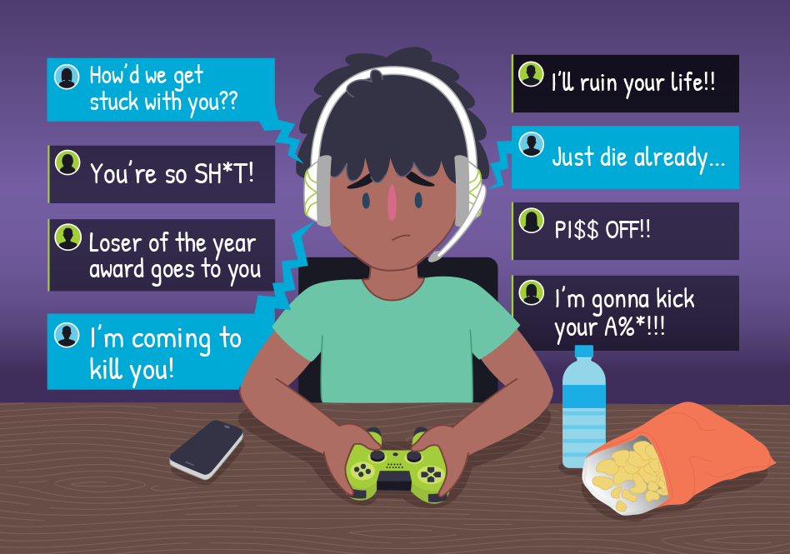


Adam 6A
Adam 6A
Is the Internet Good or Bad?
The Internet can be fun for kids
The Internet is home of social media
The Internet has fun games, such as Club Penguin. And kids can enjoy it and can keep everything fun and safe for kids
The Internet has social media! A place where we can communicate with friends and family
But there are also cyber-bullies
But what about the hackers?
We can’t be safe and happy on the Internet always, there are bullies surfing the internet and making fun of people in games.
There are hackers on social media that want to destroy peoples computers for personal stuff and bullying.
Blogging gives people a piece of you
Time to pay zir!
Sure blogging is a good thing to like let people know about you and you can show it to your friends. But…
Yes. Ahh when blog hosting services charge you for money. Almost everything on the internet charges you for money
So… Is the Internet Good or Bad?
Adam 6A
Adam 6A

